Slide 1
Summarization
Ryan Tervo
Natural Language Processing (IST 664) Fall 2022

Slide 2

OVERVIEW
What is ‘Summarization’
Types of Summarization
Available Applications
Current Commercial Products
Easy Demo!
References

Slide 3
Summarization
Definition:
Process of condensing large amounts of information into concise, consumable texts.
Benefit:
Helps readers understand complex topics quickly by reducing the topics down to their main points.
Why This is Important:
The ability to summarize large amounts of texts can save companies tremendous amount of time and resources.
https://www.summari.com/blog/six-things-you-should-know-about-text-summarization

Slide 4
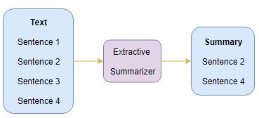
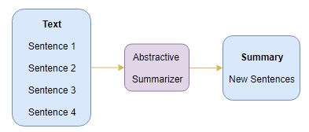
Types of Summarization
Extractive:
Finds key points & phrases from text to generate a summary.
Easy!
Abstractive:
Creates a summary based on the main ideas of the text.
Not As Easy!
https://broutonlab.com/blog/summarization-of-medical-texts-machine-learning

Slide 5
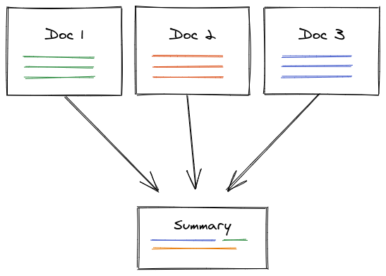
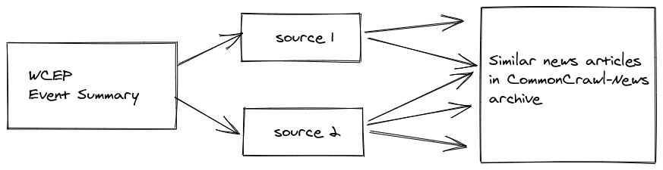
Types of Summarization
Can be used for a single or multiple documents
https://aylien.com/blog/multi-document-summarisation-and-the-wcep-dataset

Slide 6
Applications (partial list)
Major Industries:
Medical cases
Legal contract analysis
Research & Development
Patent research
Internal document review
Basic Services:
Newsletters
Books and literature
Media monitoring
Question answering and bots
Email overload
Meetings & video-conferencing
Perhaps the one that is most pertinent…
E-learning and class assignments
https://www.frase.io/blog/20-applications-of-automatic-summarization-in-the-enterprise/

Slide 7
Current Commercial Products
1. AssemblyAI’s Auto Chapters API (“Sales Department”)
*2. plnia’s Text Summarization API (10 Day free trial, $9-59/month)
*3. Microsoft Azure Text Summarization (Pay as you go, depends on usage, has free plan)
*4. MeaningCloud’s Automatic Summarization (0-$999 / month, depends on usage)
*5. NLP Cloud Summarization API (0-$499 / month, depends on usage)

Slide 8
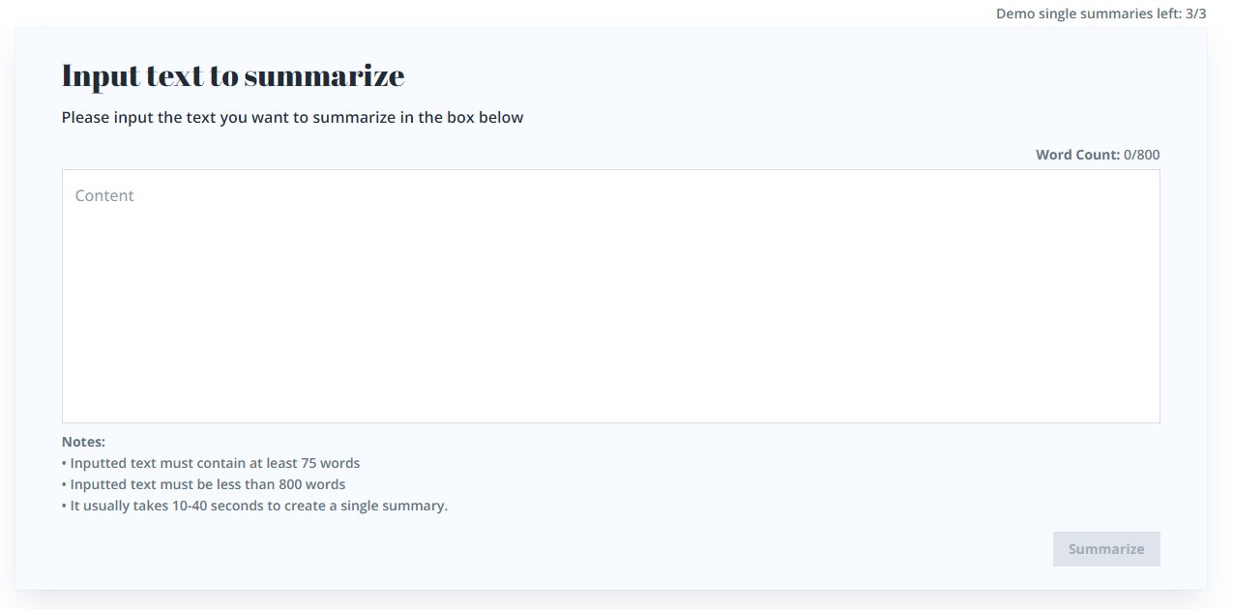
Brevi Demo! (Copy/paste directly into site, but only 3 times!)
https://brevi.app/

Slide 9
References
https://www.summari.com/blog/six-things-you-should-know-about-text-summarization
https://www.frase.io/blog/20-applications-of-automatic-summarization-in-the-enterprise/
https://marketbusinessnews.com/automatic-text-summarization-in-business/267019/
https://www.assemblyai.com/blog/text-summarization-nlp-5-best-apis/
https://monkeylearn.com/blog/natural-language-processing-applications/
https://www.topcoder.com/thrive/articles/text-summarization-in-nlp
https://medium.com/@prasasthy.sanal/brief-history-of-text-summarization-9d1b3787a707
https://broutonlab.com/blog/summarization-of-medical-texts-machine-learning
https://aylien.com/blog/multi-document-summarisation-and-the-wcep-dataset

Slide 10

Thank you!

